Slide 1
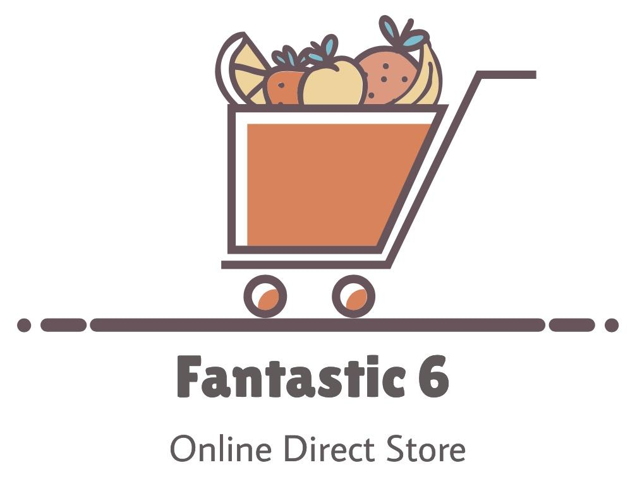
Team 4: Abram Flores, Anthony Hernandez, Vamshi Katipally, Fulya Kocaman, Wangmo Tenzing, Manthan Vasani

Slide 2
Our Goals
Put customers first
Make shopping more efficient
Spend less time browsing products
Competitive prices on goods
Limited ads on site for a more pleasant user experience

Slide 3
Our Product Vision
For on-the-go individuals who like the convenience of online shopping, F6 Online Direct Store is a web-based service that will allow customers to buy anything and everything they may want. Users will be able to search seamlessly through product web pages that will contain pertinent information related to those products, such as availability, customer reviews, specifications, and descriptions. Unlike existing online retailers, F6 Online will contain an unmatched product catalog that will span quality goods from every imaginable sector, making the
safeguarding of customer data a top priority.

Slide 4



Collaboration Tools

Slide 5
Business and Requirements

Slide 6
Background
Recognition for the need of the product:
Brick/Mortar stores have garnered large clientele
Primary growth mechanism has been word-of-mouth
Store’s name has increasingly reached customers distant from a physical location
Insensible for completely new customers to go out of their way - so, bring ABC’s products to them via Direct Store
Need for greater overall presence and visibility
Increased convenience for customers

Slide 7
Business Opportunity
Increased scalability and reach with Direct Store
A cost-saving effort
Means of connection (bridge information/time gap) - direct communication
Greater revenue potential
More shoppers can interface with ABC
Ads and product features
Appeal to customers’ desire for protection of their data
Product is in-line with current market trends

Slide 8
Business Objectives
To increase Gross Profit
Greater overall amount of purchases, more customers purchasing
To increase Net Profit Margin (profit / $1 of sales)
Indicates revenue is increasing faster than overall deductions
Anticipate operating expenses to increase, still cheaper than alternative
To increase average Customer Lifetime Value (worth of customer to business)
Expect customers to consume more goods due to improved convenience
To minimize overhead ratio (Operating Expenses/Net Income)

Slide 9
Success Metrics
Increase sales conversion rate for a week to 3%
Increase customer lifetime value (CLV) to $200.00 per year
Increase increase the gross profit margin to 40% and the net profit margin to 20%
Reduce shopping cart abandonment rate
Bring down customer acquisition cost (CAC) by 15%
Grow website traffic
Constantly improve customer service calls, chats, and emails to collect data on customers

Slide 10
Business Risks
Hacking attempt to obtain employee credentials and steal customers’ data (High)
Online security issues from suspicious or fraudulent activities (Medium)
Customer disputes and returns could create unsatisfied customers and increase costs (Low)
Violation of copyright issues could create a great deal of loss (High)
Low Search Engine Optimization (SEO) ranking could decrease sales (Low)

Slide 11
Business Assumptions
Users with Smart Device & Internet Connectivity
Convenient and appropriate UI
Server uptime nearly 100%
On-time delivery, return if defect founds -> rework -> represent
Language: English only, User input: English only
Client is responsible for providing user manuals, return policy, refund policy and privacy policy - > not part of the contract

Slide 12
Business Dependencies
Number of sellers and products
Positive reviews
Marketing
Good visual representation of products
Credit Card (Payment gateway involved, depends on banking transactions)
Delivery partners

Slide 13
Scope and Limitations

Slide 14
Major Features
-Robust user authentication
-Multiple payment methods
-Fast returns and exchanges for customers
-Updating site continuously with newest products
-Exclusive collaborations with reputable companies (for new products)

Slide 15
Scope for Releases
Initial Release:
Focus on features essential in running a successful online business
Generating profit, but not at expense of user experience
Affordable prices for community
Exclusive offers to provide best deals for customers
Availability of our products (adequate stock, cust. service)
Customer Satisfaction

Slide 16
Subsequent Releases
Emphasis on supplementary features (coupon codes, sharing to external sites)
“Desires”, not needs
Price match options
Less work on users’ part
Mobile app: shopping on-the-go (more available to users)
Portability and ease of access

Slide 17
Limitations and Exclusions
Limit of concurrent users (server may not be able to handle ten-fold increased traffic to site)
Surpassing server capacity may affect system performance
Server/database crash may lead to data loss
Budget remains fixed
Growing cost of technology/maintaining may limit other expenditures (ex. advertising, sponsorships, promotional deals)

Slide 18
Business Context

Slide 19
Stakeholder Profiles
-Examples of our Stakeholders
-Employees/Upper management
-Customer Support Company
-Business partners/Suppliers
-Investors and shareholders
What are their major values?
Attitudes towards development
Major interests within the project
Any constraints?

Slide 20
Deployment Considerations
Data Delivery
Multiple domains and servers.
Assign nearest server based on IPs.
Compressed images and videos.

Slide 21
Deployment Considerations
Time Zones
Serve local time zone based on IPs
Ask preferred time zone to serve data more efficiently.

Slide 22
Deployment Considerations
Access
User
Seller
Customer Care
Activity monitoring officer
Database/server administrator
Business and development manager
System Administrator

Slide 23
Deployment Considerations
Data Management
Requires multiple servers and data centers to handle more number of requests.
Implement load balancers
Backups

Slide 24
Artifacts

Slide 25
Product Backlog & Sprint Backlog
Product backlog has a total of 23 user stories that deal with interface, user experience, functionality & accessibility of the online direct store. Story breakdown as follows:
Story description
Acceptance criteria
Points (estimate & adjusted)
Priority
Sprint number

Slide 26
Product Backlog & Sprint Backlog
4 sprints were planned in order to effectively work on the tasks based on priority.
Weekly meetings.
Sprint backlog further divided each story into sprint tasks.
Sprint backlog was adjusted using team’s velocity.
Pending items were pushed to next sprints and reorganized based on team’s availability.

Slide 27
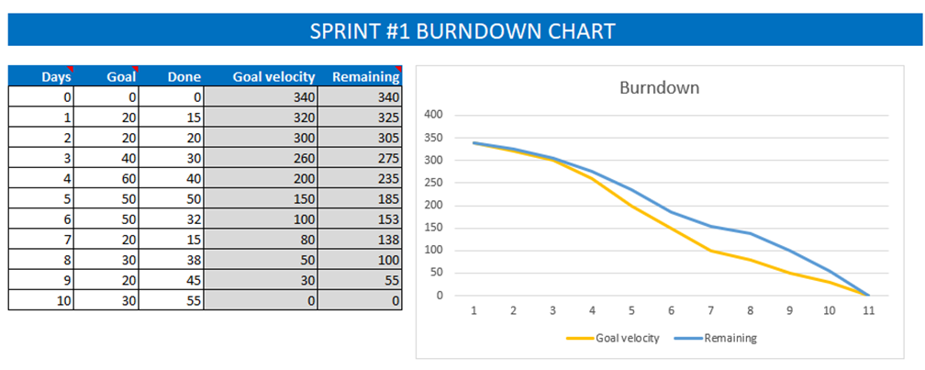
Burndown Chart Sample

